Slide 1
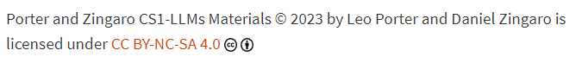
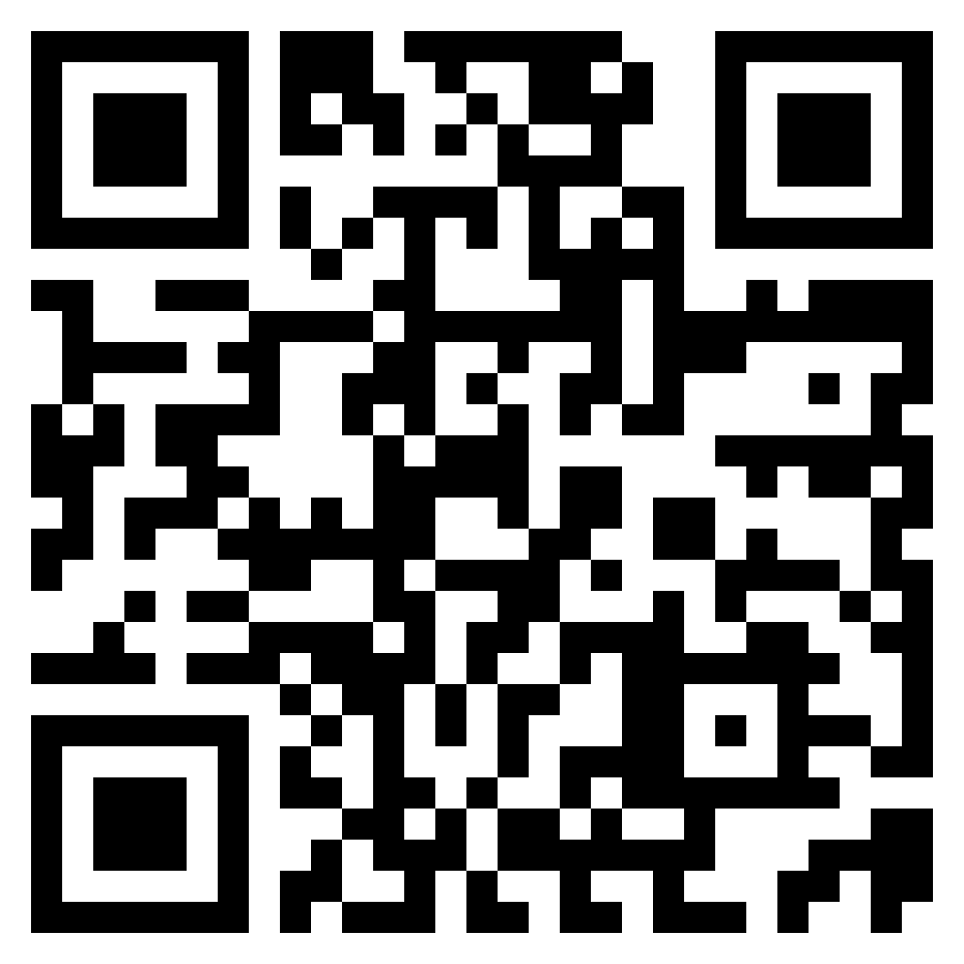
CSE 8A – Introduction to Programming and Computational Problem Solving I
Leo Porter
(Professor Porter or
Dr. Porter)
Class Website
https://sites.google.com/ucsd.edu/cse8afa23/home
Slides based on materials from Daniel Zingaro, Christine Alvarado, and Beth Simon
Notes:
I love teaching this class. Please call me Prof. or Dr. Old tradition in academia that when students start doing research with faculty or enter graduate school, it switches to a first name basis, I like to honor that as it meant a lot to me when I became a Phd student. For those of you new to UCSD, most of your faculty have PhDs, but some may not, so you can safely call everyone Professor.

Slide 2
Welcome to UCSD!
We’ll have some brief topics at the start of each class about computer science, succeeding as new students, etc.
Notes:
Welcome to UCSD. I love this school, its culture, and its location. I want to see you all be successful and may offer tips and hints here and there along with talking about topics of interest broadly to the computing community. I’ll try to spread these out throughout the quarter.

Slide 3
Meet your instructional team

Slide 4

Who Am I? Leo Porter
Research:
Research: computer science education research including assessments, pedagogies, learning analytics, prison education, LLMs
Teaching:
10th year at UCSD, 3 years previously at Skidmore College
UCSD courses: 8A, 8B, 30, 100, 141/2, 141/2L, 240A, 291-CER, 599
[Online] Coursera: Java Programming: Object-Oriented Design of Data Structures + edX MicroMasters: Data Science in Python
UCSD Service:
Direct CSE MS program and UCSD COSMOS
Past life
Officer in the Navy (2000-2004)
When I’m not working:
swimming, cycling, running, spending time with family
Notes:
Picture from Dunadd where there was a fortress starting around 800AD and where kings were inaugurated in Scotland. Like practically every day in Scotland, it was windy.

Slide 5
Who Is our Staff?
TAs:
Yousef Alhessi (RQs and Projects)
Mounika Padala (PrairieLearn)
Amanda Quach (Labs)
Adrian Salguero (Homework/Quizzes)
Annapurna Vadaparty (Labs)
Hari Yadavalli (Homework/Quizzes)
+ 33 Tutors!!!
Notes:
TODO

Slide 6
Meet your classmates!

Slide 7
How do you feel about this class?
Excited
Apprehensive
Indifferent
Curious
Tired

Slide 8
CSE8A: Introduction to Programming and Computational Problem Solving I
CS != programming
"not equal to"
Computer Science

Slide 9
Programming is to computer science as:
Plasma physics is to physics
Mathematics is to physics
Utilitarianism is to philosophy
All of the above
None of the above

Slide 10
CS == computing science
"equal to"
Computer Science is…
The science of using and processing
large amounts of information
to automate useful tasks
and learn about the world around us
(using a computer)

Slide 11
Why do we like computer science?
Because computers can do cool things!

Slide 12
Areas of Computer Science (some)
Theory
Algorithms
Artificial Intelligence
Vision
Graphics
Bioinformatics
Programming Languages
Human Computer Interaction
Computing Education Research
Networking
Systems
Architecture
Embedded Systems
High Performance Computing
Something for nearly everyone.

Slide 13
Areas impacted by CS (some)
Movies
Entertainment
Business
Investing
Law
Cognitive Science
Psychology
Biology
Chemistry
Physics
Engineering
Medicine
Health Care
Fitness

Slide 14
What are we going to learn in this class?
How to solve problems using a computer
Algorithm
Development
and Problem
Decomposition
Programming Using
Large Language Models (Copilot)
and Python
This is really our focus

Slide 15

Expect it to be…
Thrilling!
And..

Slide 16

Expect it to be…
Thrilling!
And…
Sometimes one of the most frustrating
things you’ve ever done!

Slide 17

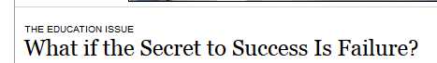
A Note about Failure and Persistence
Thrilling!
And…
Sometimes, one of the most frustrating
things you’ve ever done!
If you are not "failing", you are not
aiming high enough

Slide 18
About This Class

Slide 19
For whom is this class designed?
Notes:
Anyone without programming experience. If you have programming experience, go to CSE11.

Slide 20
My Fundamental Goals for You
If in a computing major
You have an exceptionally strong foundation for future courses as CS builds on itself
If not in a computing major
Often in your future, you will have tedious tasks that computers can solve. I want you to be able to solve them with code (using LLMs or whatever tools you want).
Notes:
Analogy If this were a class where you learned how to swim…

Slide 21
Class Syllabus
Available on our website (linked from canvas)
Class Website
https://sites.google.com/ucsd.edu/cse8afa23/home

Slide 22
Syllabus – Required Materials
Porter and Zingaro: Learn AI-Assisted Python Programming with GitHub Copilot and ChatGPT
Iclicker Physical Device (web option does not work)
There is a reading per week and associated reading quiz.
The iclicker is for in-class participation.
Notes:
First book of this sort, uncomfortable with having this book for this class given we wrote it, but there is no other book that does something similar.

Slide 23
Basics – Your grade
Readings and other online quizzes/surveys: 5%
Participation: 0-5%
Homework: 15%
Projects: 10%
Labs: 10%
Quizzes: 30%
Final: 25-30%
Readings Quizzes, Homework, Labs, and Quizzes: you can drop your lowest score.
Participation: you can miss 4 classes for full credit.
Nothing can be turned in late, no exceptions. (Use your drops judiciously.)

Slide 24
Participation
Iclickers in class (starting next Tuesday)
“Attending Class” means clicking in for >= 80% of questions
You can get 100% for 5% of the grade for the course (and your final is worth 25%) by missing fewer than 4 classes.
If you miss more than 4 classes
You get 100% for this portion of your grade: (#attended/#total)*5%
and your final is worth 25%+(#missed/#total)*5%
E.g., if you attend 9/18 classes, you’d get 100% for 2.5% of your grade and your final is worth 27.5% of your grade.
Class on November 21st will not require attendance
Likely will be remote
All lectures are podcasted
More about in-class activities shortly

Slide 25
Reading Quizzes/Surveys
Surveys are periodically offered. Completion is all that’s required for credit.
Reading Quizzes are generally due on Tuesdays and hosted on PrairieLearn
Next Tuesday is a large-ish reading quiz. Skim Chapters 1 and 2. Read chapter 3 carefully.
Also complete the required (for financial aid and credit) syllabus quiz on canvas
Worth 5% of your grade
Can drop lowest reading quiz (but can’t drop missing surveys)

Slide 26
Homework
Delivered on PrarieLearn
Many opportunities to retry questions and learn the material
Homework is about learning the concepts and preparing for exams. You can get help from friends, tutors, the internet, LLMs, etc.
Make sure you use the help to learn the content, not just get the answer
Due on Mondays
Worth 15% of your grade (can drop 1)

Slide 27
Labs
Weekly on Wednesday.
Must attend enrolled section in-person every week.
Lab sections will either:
Have an activity (lab) with a short set of questions at the end
Be a quiz (with a possible take-home lab)
Labs are to help you get started with a new topic in the class and you work with partners
Worth 10% of your grade (can drop 1)

Slide 28
Projects
3 projects over the term
Tentatively due weeks 6, 8, and 10
Open-ended, I want you to create something amazing that you can be proud of!
Turn-in will be on gradescope
Worth 10% of your grade. (No dropped project)
More details later this quarter

Slide 29
Quizzes
4 quizzes over the term
Administered via prairieTest/PrairieLearn during Lab
Must attend lab in-person to take the quiz
Bring student ID card.
Worth 30% of your grade
Drop your lowest score

Slide 30
Final Exam
Administered via prairieTest/PrairieLearn during the final exam time
Must attend the final in-person to take the exam
Aim to host this in the computer labs
If not, you may need a laptop with a batter that can last 3 hours
You can get a loaner laptop from campus, details in the syllabus
Bring student ID card for all exams
Worth 25-30% of your grade

Slide 31
Discussion
Optional on Fridays
Problem solving sessions with questions similar to homework and exams
Bring your questions
These sessions can be extremely valuable but are historically under-utilized

Slide 32

This Course is Still Under Construction
First run of this course
Anywhere in the world, as far as we know
Made huge changes all at once
Implication: please be patient with us
CLASS

Slide 33
Lecture Format

Slide 34
What do I do in class?
Think of me as your tutor
Be your guide in inducing you to explore concepts
Create situations and post problems that set the scene for your exploration
Answer your questions
Not spend lecture reading the textbook to you with slightly different words

Slide 35
What do you do in class?
Prepare your brain to maximize in-class learning
Reading, Reading Quizzes
In class: engage with your neighbors and the class via chat and breakout groups
Turn them upside down and sideways, think about what common errors or misconceptions might be
Seek help and seek to help others
In class, forums, office hours, discussion section
I expect each class member to contribute to a positive environment of mutual aid and cooperation

Slide 36
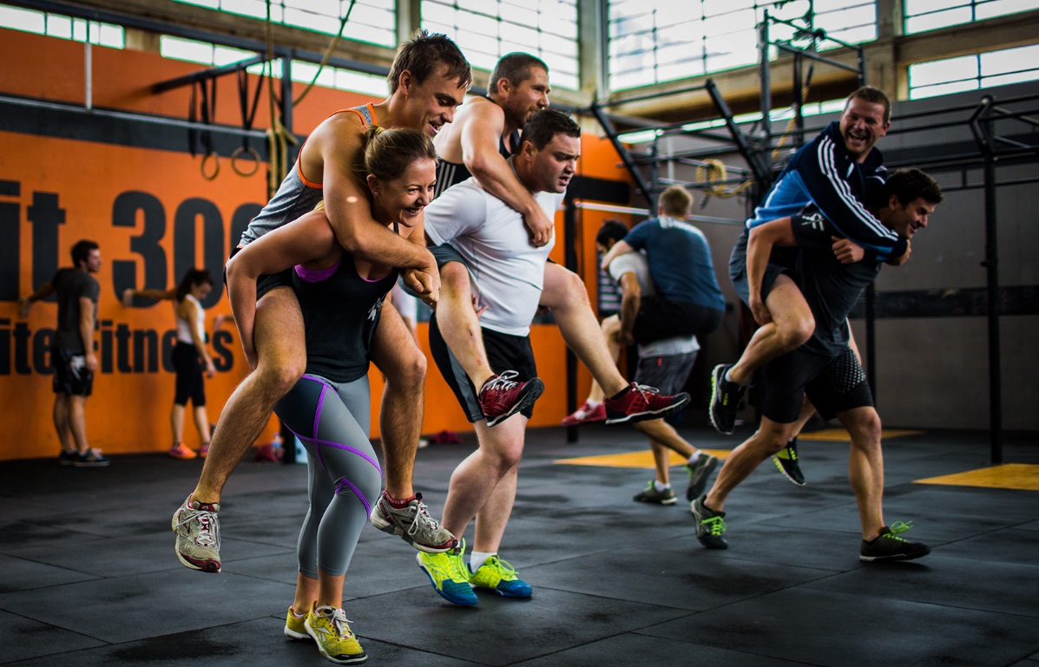
FAQ: "But professor, wouldn't it be more efficient if you just taught us with the right answer to begin with?"
Have you ever heard of a workout class where the instructor did all the exercises while everyone else just watched attentively?
www.meetyourpersonaltrainer.com.au

Slide 37
FAQ: "But professor, wouldn't it be more efficient if you just taught us with the right answer to begin with?"
Have you ever heard of a workout class where the instructor did all the exercises while everyone else just watched attentively?
Me neither
To learn, YOU must do the work with your own muscle (your brain)
www.meetyourpersonaltrainer.com.au

Slide 38
Why discuss?
Explaining/Discussing is an essential skill in the job market
Teaching/explaining is one of the BEST way to learn material
and we have evidence you learn from discussion

Slide 39
Tips for a good discussion in breakouts
Take turns being the first one to talk
Once you all agree on the answer, don't stop!
Always go over each wrong answer and explain why it is wrong
Also interesting and useful to think about why someone might be tempted to choose the wrong answer
Even if your group-mate has said something very clearly and correctly, it's a good idea to repeat it yourself
"So, what I think you said was, …"
Might seem pointless, but your brain will remember it better if YOU say it too

Slide 40
Peer Instruction
Studies have shown it helps both with conceptual understanding and student course outcomes.
Meta review of active learning published in the Proceedings of the National Academy of Sciences compares studies of active learning against a control (lecture). It states:
If the experiments analyzed here had been conducted as randomized controlled trials of medical interventions, they may have been stopped for benefit—meaning that enrolling patients in the control condition might be discontinued because the treatment being tested was clearly more beneficial.
Freeman, Scott, et al. "Active learning increases student performance in science, engineering, and mathematics." Proceedings of the National Academy of Sciences 111.23 (2014): 8410-8415.

Slide 41
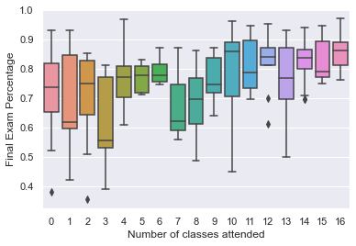
Participation in CSE 142 vs. final exam score
Notes:
Not the strongest correlation, but if I were looking at this, I’d see that attending class is loosely correlated with higher grades. Correlation is not causation.

Slide 42
Warmup Question
How many of the following statements are true?
Pineapple is a good pizza topping
Minecraft is the best survival video game
A hotdog is a sandwich
UCSD’s student culture embraces working hard
A: 0 B: 1 C: 2 D:3 E:4

Slide 43
Course resources and How to Get Help
There are ~550 students enrolled in this course right now and 1 Instructor (but 39! total Instructional Staff).
You’ll likely need help this quarter – we want you to know the best way to reach out for help so your questions are answered.

Slide 44
Primary Resources
Class website
Canvas (podcasts, some quizzes, files, grades)
Piazza for conceptual/homework questions
Private posts for personal questions
PrairieLearn for Reading Quizzes/Homework
PrairieLearn+PrairieTest for Quizzes/Final
Gradescope for turning in HW0 and Projects
Annotated Lectures in Google Drive Folder
All these are linked from the class website!
Notes:
Show Piazza post!

Slide 45
Resources (continued)
Office Hours:
Coverage throughout the week. PLEASE COME TO OH!
Office Hours are for conceptual questions (debugging lab questions are for “Lab Hours”)
- Office Hours and lab hours are sometimes in-person and sometimes remote, check calendar for details.
Private piazza post or E-mail Professor (if you feel it is too personal) for major issues (death in family, hospitalization)
Piazza is monitored by the whole course staff and you will get a response, and the response is more timely!

Slide 46
Resources – Getting Help Examples 1
“I’m sick….”
Can miss 20% of classes, drop one homework, drop one reading quiz, drop one lab, and drop one quiz.
Use this one drop judiciously!!!
Issues impacting the Final Exam require exceptional circumstances, e-mail professor or post privately on piazza
Disability
E-mail paperwork from campus disability services to the Professor by the end of week 2.
Notes:
Sadly COVID impacts aren’t exceptional anymore…

Slide 47
Resources – Getting Help Examples 2
Am I allowed to use dataset X for Project 1?
piazza
I’m lost on the homework – I don’t know what an “if” statement does
Office Hours (maybe discussion)
I need to turn in the <homework/projects/RQ> late
No late work in this class (you get to drop one)

Slide 48
Resources – Getting Help Examples 3
I forgot my clicker
Sorry, participation is completely managed electronically, but you can miss 4 classes
In-depth class concept question (e.g., what’s the difference between “for” loops and “while” loops)
Class or Discussion (possibly piazza)
I can’t get into canvas
E-mail Academic Services (ACMS) if you can't log in (servicedesk@ucsd.edu). Private piazza post if waitlisted and can't see course.

Slide 49
Resources – Integrity Policy
Read and sign the Academic Integrity Agreement (part of HW0)
Quizzes and Final Exam
Standard deal, only your own work
Homework/Projects
Never okay to look for solutions online when crafting your solution
Can use TAs, Tutors, LLMs, general web resources for help

Slide 50
Resources – Inclusive Classroom Environment
General rule: be kind to one another and be accepting and welcoming of different views
Everyone is welcome in this space – let us know how we can help you succeed
Financial Aid, OSD, Parents, Veterans, etc.!
In turn, harassing and discriminatory behavior are never okay. Notify me immediately if you experience it.

Slide 51
Summary: how this class works.... (and how you can succeed)
READ the book! And do online quizzes.
Don’t slack – catching up can be HARD
So before class, you should have a feel for the basics
In class, we tackle the hard stuff – PARTICIPATE and ENGAGE
Labs help you get started solidify understanding
Homeworks help you test yourself on key concepts and we'll get you more feedback on your understanding
Quizzes help you gauge your level of learning and help ensure good progress
Projects let you demonstrate the skills you are learning!
Exams – measure your understanding

Slide 52
Diving into the course!

Slide 53
What I care about you learning in this course!
Declarative Understanding
Examples: LLMs can be wrong. “Open-boxed testing” means you have access to the source code.
Procedural Understanding
Examples: When given a type of problem you’ve seen before, you can apply the algorithm to solve it
Conceptual Understanding
Examples: Given a new type of problem, you can apply your conceptual model of computation to solve it

Slide 54
Learning Programming is Learning a Skill!!
You are learning a skill like playing a musical instrument or a sport
Constant practice is needed. You need to change your brain/muscular wiring to be successful.
Takeaway: This is not a class where you can cram and pass. Make time to practice nearly every day (we’ve built this into the course to help you succeed).

Slide 55
LLMs have dramatically changed how we program!
Notes:
Wait, what’s an LLM?

Slide 56
Have you heard of ChatGPT?
Yes, I think I understand what it does
Yes, but I don’t really understand what it does
A little bit
Not really
Not at all

Slide 57
Wait, what’s an LLM?
Fill in the following
I took my daughter to swim _______
I really didn’t like the ending of that ________
The clouds ______
# output variable val to the screen
___________________
Notes:
It’s just text prediction, and that works for programming too

Slide 58
LLMs for programming in the news
Satya Nadella, CEO of Microsoft:
"Just like the rise of compilers and interpreters, we believe AI-assisted coding will fundamentally change the nature of software development, giving developers a new tool to write better code easier and faster"
Developers are able to code 50% faster using Copilot
Jensen Huang, Nvidia President and CEO:
"This computer doesn’t care how you program it, it will try to understand what you mean, because it has this incredible large language model capability. And so the programming barrier is incredibly low"
https://www.protocol.com/newsletters/protocol-enterprise/microsoft-ignite-defender-copilot-mobileye
https://www.cnbc.com/2023/05/30/everyone-is-a-programmer-with-generative-ai-nvidia-ceo-.html

Slide 59
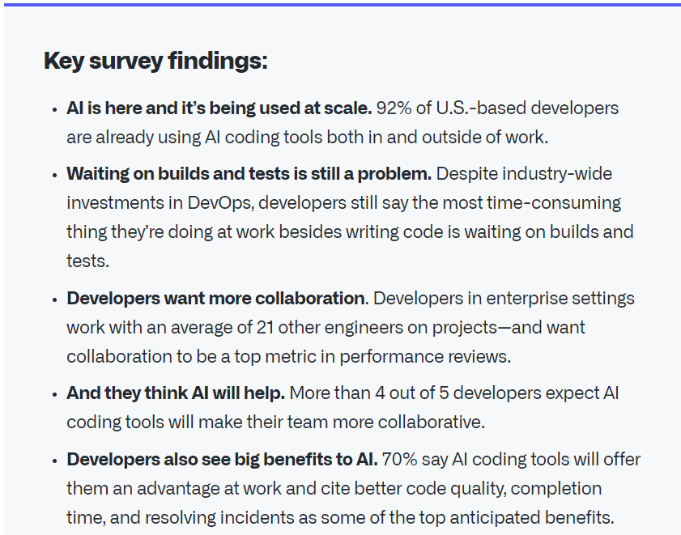
LLMs can aid professional Software Engineers (1)
Software developers are using these tools.
I believe we need to help you use these tools responsibly.
https://github.blog/2023-06-13-survey-reveals-ais-impact-on-the-developer-experience/

Slide 60
LLMs can aid professional Software Engineers (2)
Study on the Impact of Copilot on Developer Productivity [1]
Professional software developers (n=95) were asked to write an HTTP server in JavaScript
Controlled experiment: treatment group used Copilot, control group did not
Copilot group completed the task 56% faster
"Our results suggest that less experienced programmers benefit more from Copilot."
Peng et al. The Impact of AI on Developer Productivity: Evidence from GitHub Copilot. arXiv:2302.06590, 2023.

Slide 61
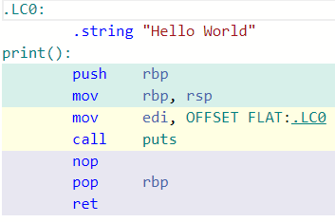
A new interface?
Before LLMs
Assembly code
Python Code:
print(“Hello World”)
Python ByteCode
After LLMs
Assembly code
Prompt
# output “Hello World to the screen”
Python Code:
print(“Hello World”)
Python ByteCode

Slide 62
Copilot/ChatGPT/etc. are amazing
Copilot solves 50-80% of classic introductory programming problems [1,2]
I’ve transitioned into having it on all the time when I program
It’s not that different than my looking up examples on stack overflow, library documentation, and making it my own
But it’s really nice to have it in my workspace and have it adapt to my code
Denny et al. Conversing with Copilot: Exploring Prompt Engineering for Solving CS1 Problems Using Natural Language. ACM SIGCSE 2023.
Denny et al. Computing Education in the Era of Generative AI. arXiv:2306.02608. 2023.

Slide 63
Copilot/ChatGPT/etc. aren’t replacing programmers anytime soon (imo)
Most of professional programmer time isn’t spent coding the kind of things Copilot solves well anyway
It’s deciding on the software architecture, interacting with other teams, etc.
LLMs can be hilariously wrong (in a way that compilers cannot)
They need experienced supervision

Slide 64
So what do we learn then?
How to:
Read code
Modify prompts
Test code
Break large problems into smaller problems
Debug code
How to write software for multiple domains
And, yes, still write code ourselves without Copilot
These are the most important things you want to learn in an introductory computer science course anyway!!!

Slide 65
VSCode + Copilot Demo
Notes:
Show VSCode, code window, etc.

Slide 66
Class Flow
First 4 weeks – Learning the core programming constructs (variables, conditionals, loops, function) and data structures (lists, strings) + learning the workflow with LLMs
Week 5-6 – Data science (+files, dictionaries, testing)
Week 7-8 – Images (image filters, 2D arrays, problem decomposition)
Week 9-10 – Games (deeper look at problem decomposition and debugging)
Notes:
TODO

Slide 67
Todo for Next Class
Sign into all the systems listed on the main page
Bring your clicker and register your clicker on canvas
HW0 (on canvas) due next Wednesday:
Complete the syllabus quiz (#FinAid) on canvas
Complete the Academic Integrity Agreement Form
Complete “setting up your environment” and submit on gradescope
Also complete the “Practice Lab Exercise” to make sure Copilot is working for you on PrairieLearn for lab next Wednesday.
There’s also a check to make sure Copilot is working for your lab Wed.
Complete the “Pre-Class Getting to know you survey”
Complete the reading quizzes for Tuesday
RQ1 and RQ2
Lot of reading up front, it’ll quiet down as the term progresses
Notes:
Mention extension

